Slide 1
2020 Annual General Meeting
August 13, 2020

Slide 2
2019 HIGHLIGHTS
Accomplishments
Challenges
Over $125,000 in fundraising
Rescued over 500 cats
Regina Cat Coalition continues
Creation of new volunteer positions
Increased membership
Continued cat overpopulation crisis and pressure from the community to rescue more cats
Potential for volunteer burnout
Elimination of PetSmart Charities TNR grant means shortfall of $10,000
COVID-19 pandemic

Slide 3
BOARD
Highlights & Challenges
Goals
Financial management allowed rescue of high number of cats
Financial buffer to weather the COVID crisis
Conflict of Interest policy
Separation of Treasurer and Bookkeeper duties
Succession planning
Reduce co-chairs’ workload
Meaningful impact of Regina Cat Coalition
Accurately projecting intake and vet costs

Slide 4
VOLUNTEER TEAM
Volunteer Numbers
Highlights & Challenges
Western Pizza booth: 36 events, 113 volunteers, >3000 hours, $37,700
Staffed 4 craft fairs, garage sale, QCM marathon, Petsmart laundry
17 Excalipurr regulars
~400 on Volunteer Facebook group
51 new potential volunteer applications
Increased RCR memberships
Annual members: 56 (increased from 39 in 2019)
Lifetime members: 35
Most engagement ever at Mosaic Stadium events
70+ attended volunteer appreciation picnic
Goals
More Mosaic and Bingo volunteers
Re-engagement for Mosaic events next year
Continued increase in memberships

Slide 5
FUNDRAISING
Fundraising numbers
Highlights & Challenges
Goals
$125,902 total
Events $67,617
Bingos $22,604
Mosaic $35,681
800 people in attendance at events
Online 50/50s generated >$20,000 net funding
Winter raffle change
Electronic donation tracking
New and diverse events
Attracting and retaining reliable volunteers for bingos and Mosaic events

Slide 6
COMMUNICATIONS
Highlights & Challenges
RCR survey
Website improvements
Custom tote bag with membership
Clothing and calendar sales
RCR thank you cards
Volunteer challenges
Instagram verification
 | July 2020 | Increase since March 2019
Instagram | 5,569 | +40%
Twitter | 1,162 | +8%
Ebulletin | 963 | +31%
Facebook | 9,086 | +16%
Website | March 2019 | Year over year increase
Page views | 483,000 | +58%
Visits | 75,200 | +21%
Audience size (unique visits) | 80,200 | +55%
Goals
Recruit co-chair
Re-engage Volunteer photographers
Develop messaging calendar
Website redesign

Slide 7
PET RESCUE
Highlights & Challenges
Managed record number of intakes and adoptions
very high number of requests
early snowfall
4 satellite adoption partners
6 adoption events
 | 2019
Cats rescued | 522
Cats adopted | 480
Sterilizations | 469
Euthanizations | 9
Foster homes | 114
Goals
Public awareness and education on importance of sterilization

Slide 8
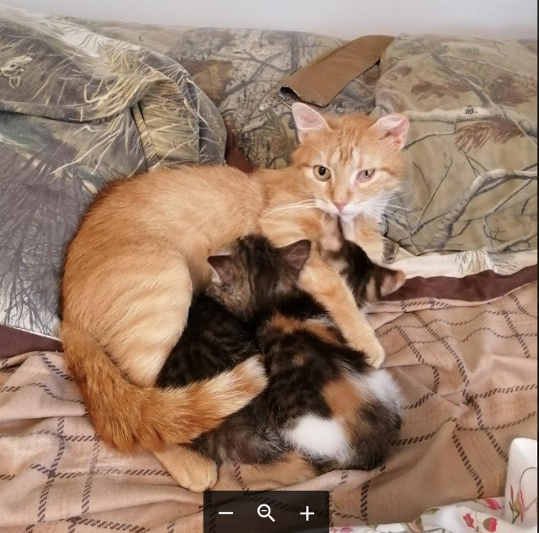
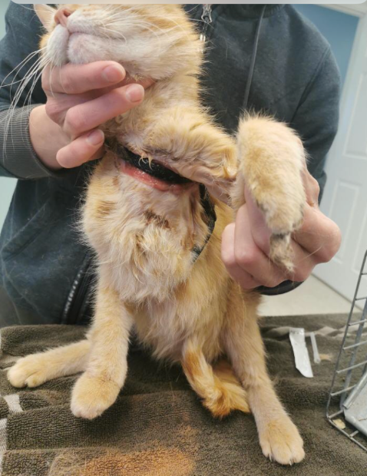
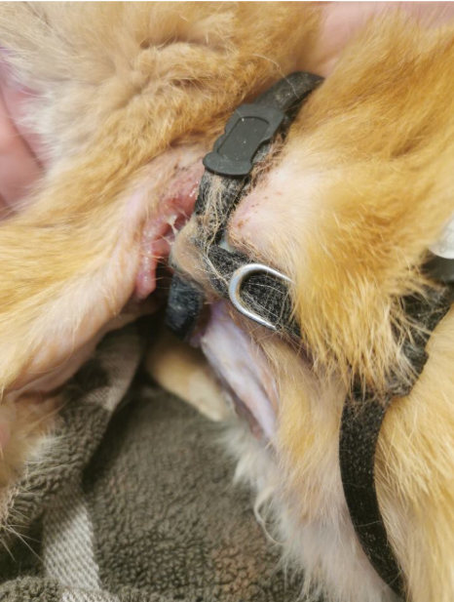
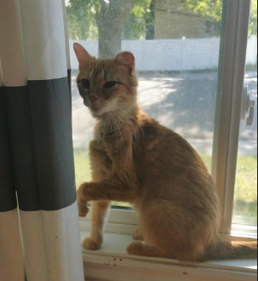
LOVEY

Slide 9
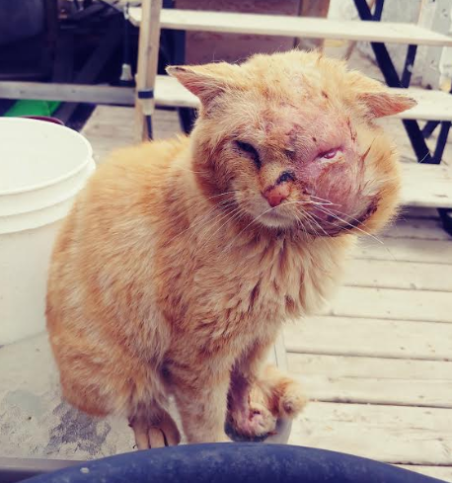
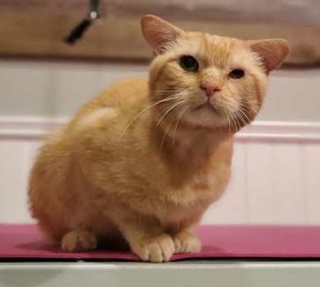
NASH

Slide 10
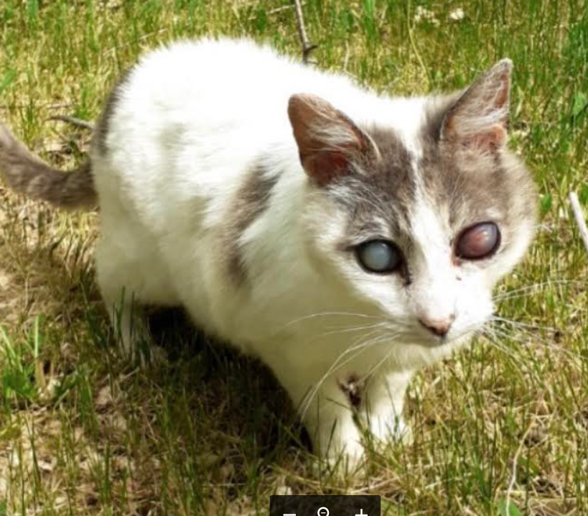
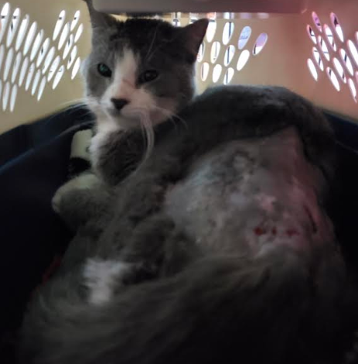
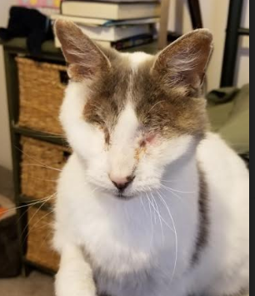
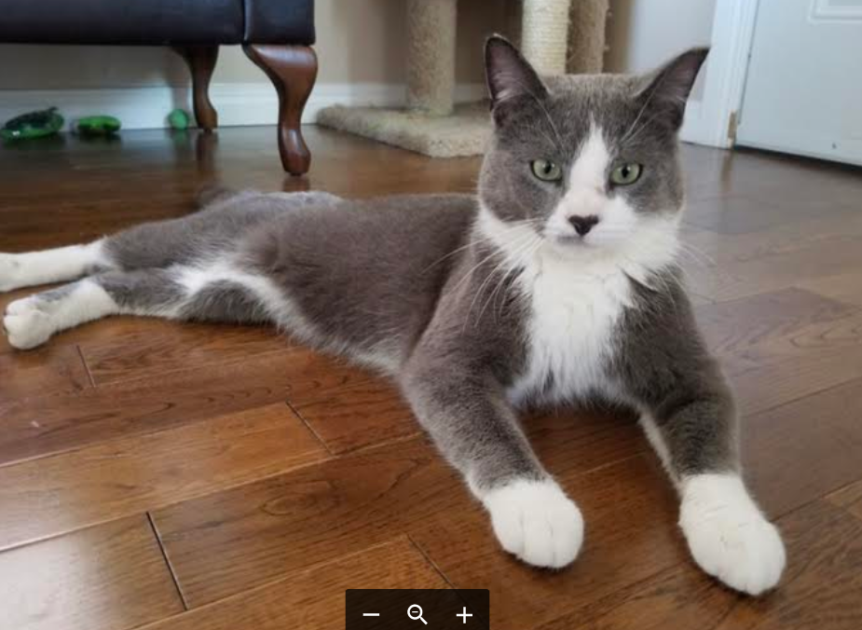
JAKE
ANDREW

Slide 11
COMMUNITY CAT TEAM
25 RCR colonies
48 private citizen colonies
RCR colonies | 2019
TNR | 4
Litters of kittens | 2
Feral kittens into foster care | 4
Tame cats into foster care | 16
Deceased cats | 7
Highlights & Challenges
Filled 3 volunteer feeding positions
Made 55 winter shelters
Stolen and vandalized feeding stations
Other locations | 2019
TNR | 12
Tame kittens into foster care | 16
Tame cats into foster car | 16
Goals
Increased trapping at RCR colonies
Replacement of old feeding stations and shelters

Slide 12
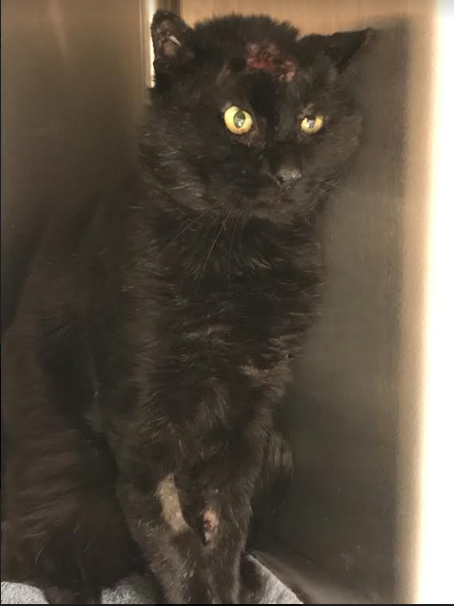
PEEPERS

Slide 13
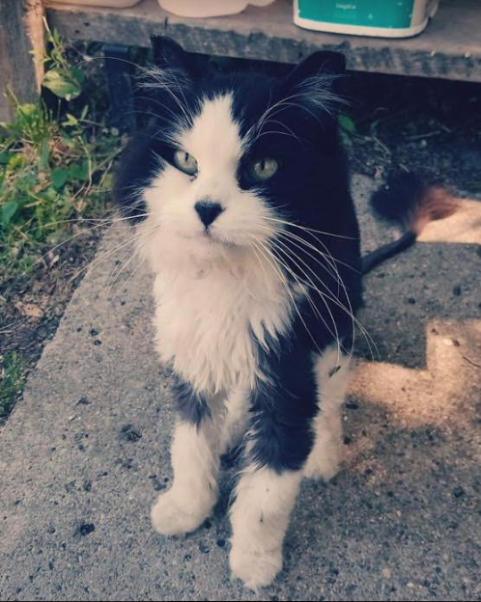
FAREWELL TO HAPPY

Slide 14
COVID-19
People staying home has driven high demand for adoptions
Communications on how to help RCR during pandemic
Cancellation of significant fundraising activities including Mosaic/Western Pizza events, bingos, book sale, garage sale, trade shows
Shifted to non-contact revenue generation activities
Contactless clothing sales
Online shop pages
Zoom concerts, fitness classes, cooking, cocktail classes
Spring plant fundraiser
Recycling drive

Slide 15
2020 Annual General Meeting
August 13, 2020

