Slide 1
2021 Annual General Meeting
April 20, 2021

Slide 2
2020 HIGHLIGHTS
Accomplishments
Challenges
Record breaking year in spite of COVID-19 challenges
Over $133,000 net fundraising revenue
Over $114,000 cash donations
Rescued/treated 615 cats
541 adoptions
Continued evolution of volunteer positions
COVID-19 pandemic!!!
Continued cat overpopulation crisis and pressure from the community to rescue more cats
Potential for volunteer burnout

Slide 3
BOARD
Highlights & Challenges
Goals
Increasing financial buffer
Policy updates
End partnership with Excalipurr Cat Cafe
Succession planning for co-chairs and Board
Organizational review
Utilize cash surplus most effectively
Meaningful impact of Regina Cat Coalition

Slide 4
VOLUNTEER TEAM
Highlights
Highlights & Challenges
Recycling program - 8 volunteers
Mask making 10 volunteer $10,000
Online clothing sales and central pickup point
Dedicated volunteer made popular cat beds
Delivered purchased merchandise to homes
Few volunteer opportunities for young people
Events cancelled due to COVID
Difficult to keep volunteers engaged
Lost good “entry point” with ending Excalipurr Cat Cafe partnership
Volunteer numbers
Goals
71 new volunteer applications received
Volunteer team took on applications to foster - 23 processed in Nov/Dec
Re-engagement of volunteers
Appreciation

Slide 5
FUNDRAISING -
Fundraising numbers
Highlights & Challenges
Goals
$83,425 total - mostly from events
7 Zoom events
2 online silent auctions
3 plant fundraisers
Mask sales
2 online 50/50s
Online 50/50s generated >$36,000 net funding
Successful online silent auctions support local community
Electronic donation and tracking for silent auctions
RBC Day of Service grants may not be available
Working with small businesses on safe option events that encourage public to support local businesses
More virtual fundraiser opportunities utilizing past successful formats

Slide 6
COMMUNICATIONS
Highlights & Challenges
New co-chair
Supported increases in fundraisers, rescues and adoptions with social media and communications activities
2021 calendar, holiday cards, merchandise
Bottle feeder orientation & training
2 Covid-19 compliant popup sales
Increased demand of volunteer time due to Covid-19
Social media followers | Dec. 2020 | Increase from 2019
Instagram | 6,267 | +26%
Twitter | 1,212 | +6%
Ebulletin | 1,048 | +17%
Facebook | 9,535 | +12%
Website | 2020 | Year over year increase
Page views | 714,000 | +47%
Visits | 135,000 | +61%
Audience size (unique visits) | 108,000 | +35%
Goals
Finish website redesign
Reach 10,000 Instagram followers to get increased functionality on platform

Slide 7
PET RESCUE
 | 2019
Cats rescued | 595
Cats adopted | 541
Sterilizations | 485
Euthanizations | 13
Foster homes | 82
Highlights & Challenges
Covid caused vet slowdown/waitlist for chekckups and sterilizations
Loss of satellite partners (PetSmarts / PetValu) at times due to pandemic
Managed a record number of rescues in 2020 - planning, patience, communication and teamwork
Good relationships with Prezoomably Cats and Albert North
New volunteer fosters
Goals
Improved workload management
Effectively manage impacts from Covid-19
Increase number of foster homes
Open communication with RCR teams and co-chairs
Utilization of cat cabbies
More street team members

Slide 8
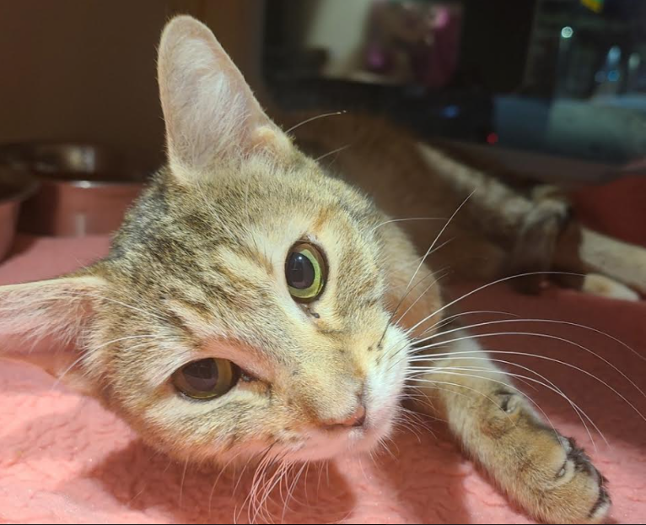
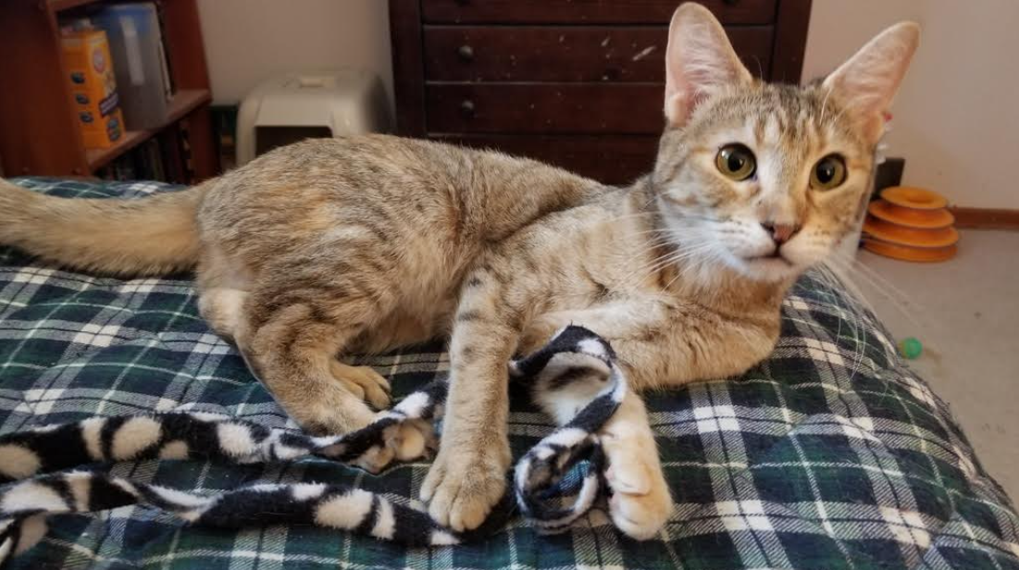
KRISTIN

Slide 9
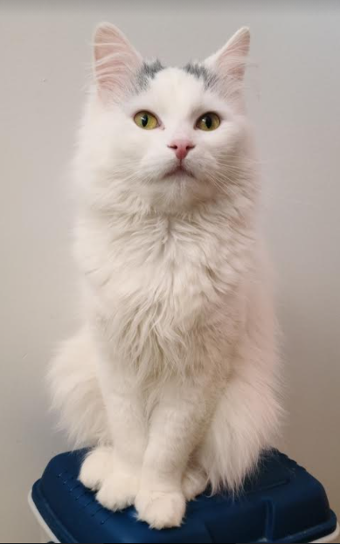
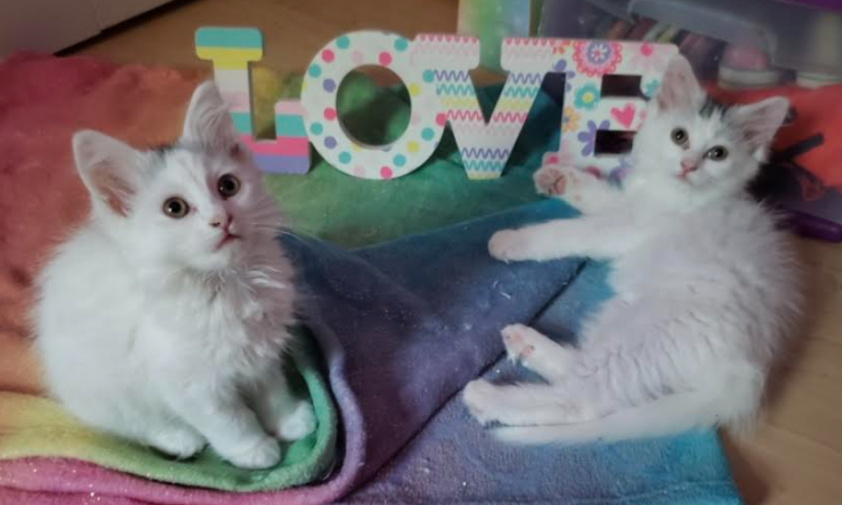
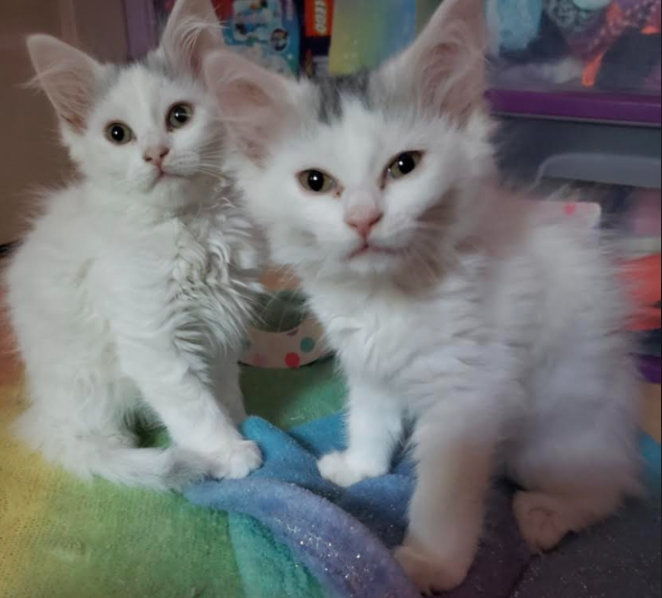
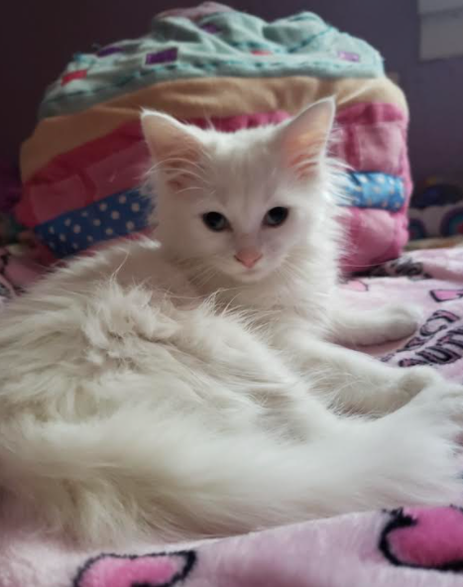
BLOOM

Slide 10
COMMUNITY CAT TEAM
26 RCR colonies
49 private citizen colonies
RCR colonies | 2020
TNR | 14
Litters of kittens | 7
Feral kittens into foster care | 44
Tame cats into foster care | 22
Deceased cats | 6
Highlights & Challenges
6 new volunteers joined community cat feeding team
1 new volunteer joined trapping team
Made ~120 winter shelters
Due to Covid, unable to start spring trapping until later in the spring resulting in an increase in litters of feral kittens trapped
Other locations | 2020
TNR | 6
Litters of kittens | 6
Tame kittens into foster care | 11
Tame cats into foster car | 8
Goals
Build new feeding stations
Get all unsterilized RCR colony cats trapped, so less kittens born this year

Slide 11
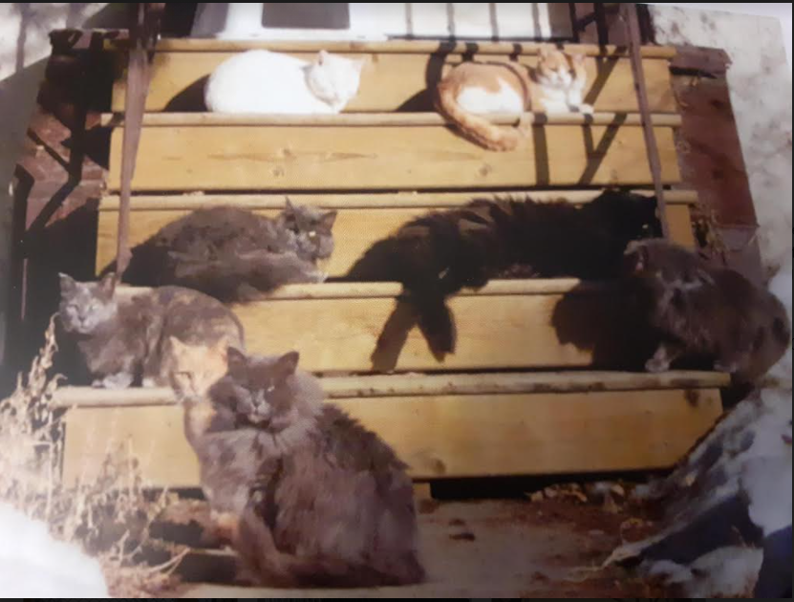
Farewell to the last of the Garnet Street Cats

Slide 12
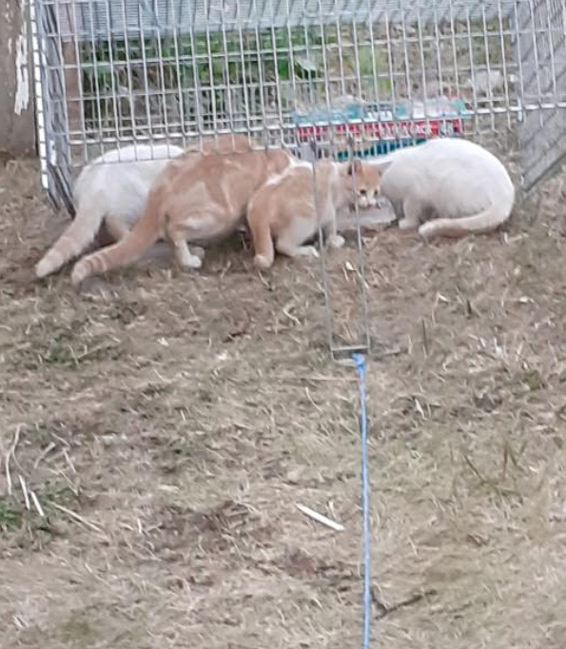
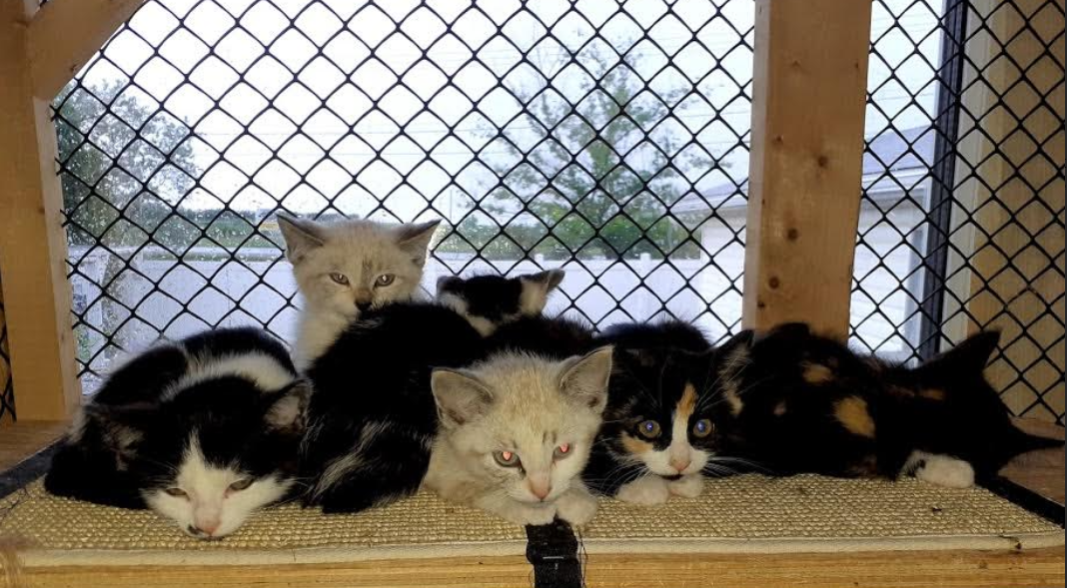
FERAL KITTENS

Slide 13
2021 Annual General Meeting
April 20, 2021

